Slide 1
Wildfire Radar: Real-Time Forest Fire Detection and Alerts Revolutionizing Forest Fire Monitoring with Cutting-Edge Technology Team Name: clueless osm hackfest 2081-08-08
Team member’s
Sabin Bhattarai
Sumit Kumar Sah
Subesh Ghimire

Slide 2

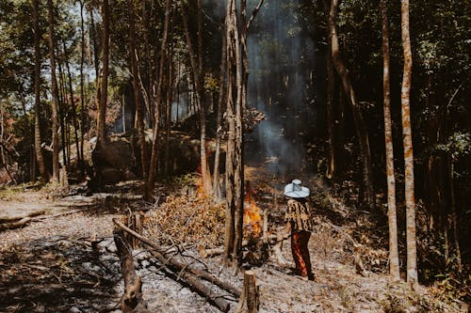
The Big Problem
Global Impact of Wildfires:
Annual destruction of over 4 million hectares of forests.
Causes $50+ billion in damages annually.
Threatens lives, wildlife, and ecosystems.
The Gap:
Existing systems are slow and lack real-time accuracy.
Communities remain uninformed until it’s too late.

Slide 3
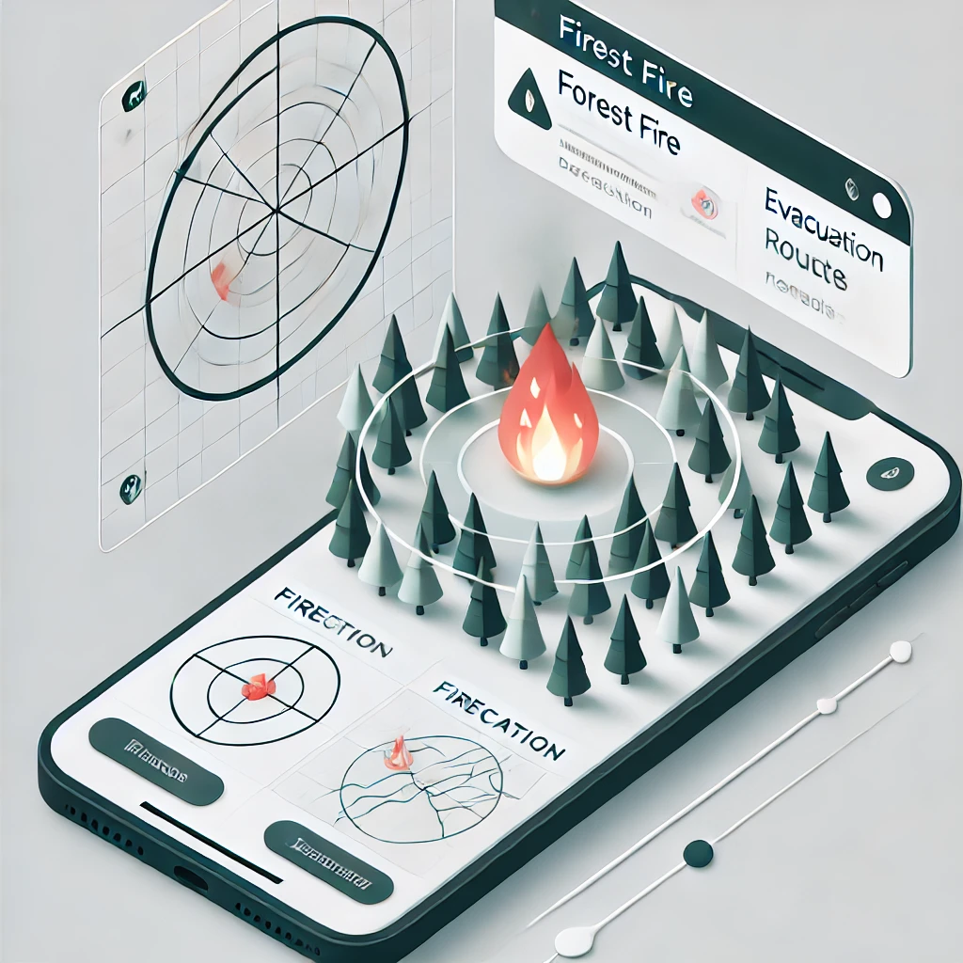
Our Game-Changing Solution
Wildfire Radar:
Real-time, localized wildfire detection and alert system.
Empowers communities with actionable information.
AI-driven insights for faster, smarter responses.
Accessible and user-friendly platform.

Slide 4
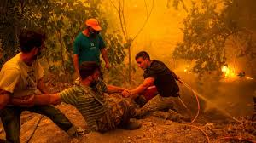

How Wildfire Radar Works
Detection:
Machine Learning Model trained on past data.
Processing:
Filters false positives using machine learning.
Real-Time Alerts:
Sends location-based notifications to at-risk users.
High risk of fire today !!!

Slide 5
Social and Environmental Impact
Immediate Benefits:
Saves lives by providing early warnings.
Reduces environmental destruction.
Long-Term Vision:
Using custom sensor to get an accurate data.
calculates safe paths, avoiding fire zones and blocked areas.
Preloaded maps ensure guidance even without network connectivity.

Slide 6
Evacuation System Overview
Dynamic Routing:
AI calculates safe paths, avoiding fire zones and blocked areas.
Real-Time Updates:
Routes adapt based on changing fire conditions and wind directions.
Offline Access:
Preloaded maps ensure guidance even without network connectivity.
User-Friendly Design:
Clear instructions and visual maps for easy navigation.

Slide 7
Tech Stack and Budget
Frontend: XML for dynamic user interfaces. (Android Studio)
Backend: Kotline and Java for robust data handling.
AI & ML: scikit learn for predictive modeling and routing algorithms.
APIs: OpenStreetMap, and weather APIs.
---------------------------------------------------------------------------------------------------------------------------------
Development Time: 3 to 6 months.
Estimated Cost: Rs50,000–Rs5,00,000, depending on the complexity, features, and team location.

